Slide 1
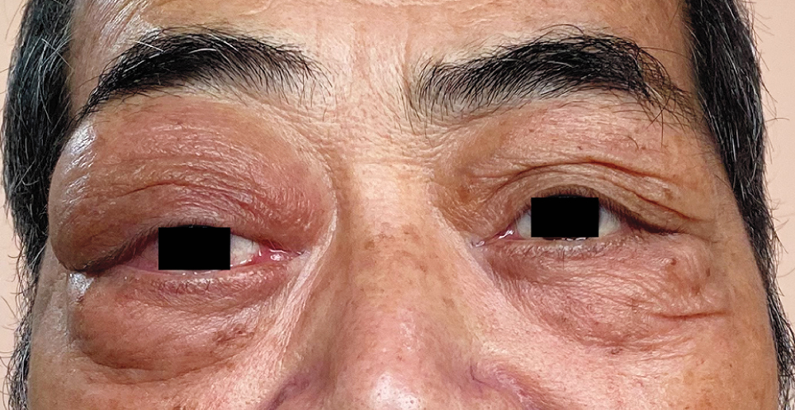
Image Challenge
Q:
A 67-year-old man presented with a 1-year history of bilateral eye swelling and right eye protrusion and a 2-week history of blurry vision. There was no swelling of the parotid or submandibular glands. MRI of the orbits showed bilateral lacrimal gland and lateral rectus muscle swelling as well as mass lesions surrounding the optic nerves. He was initiated on daily prednisone with improvement in his symptoms. What is the diagnosis?
1. IgG4-related ophthalmic disease
2. Non-Hodgkin's lymphoma
3. Sjogren’s syndrome
4. Tuberculosis-related dacryoadenitis
5. Thyroid eye disease

Slide 2
Image Challenge
Q:
A 67-year-old man presented with a 1-year history of bilateral eye swelling and right eye protrusion and a 2-week history of blurry vision. There was no swelling of the parotid or submandibular glands. MRI of the orbits showed bilateral lacrimal gland and lateral rectus muscle swelling as well as mass lesions surrounding the optic nerves. He was initiated on daily prednisone with improvement in his symptoms. What is the diagnosis?
Answer:
IgG4-related ophthalmic disease
The correct answer is IgG4-related ophthalmic disease. Serum IgG4 levels were elevated and biopsy specimen of the right lacrimal gland showed lymphoplasmacytic infiltrate with IgG4-positive plasma cells.

