Slide 1
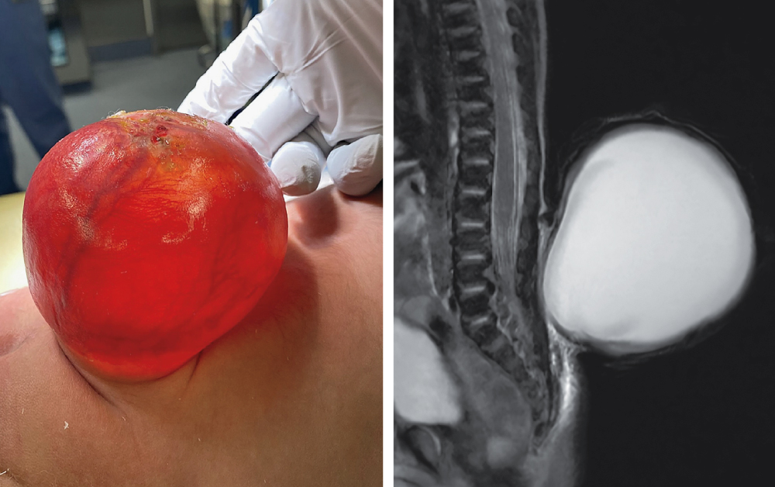
Image Challenge
Q:
A newborn boy was admitted to the neonatal intensive care unit for management of a congenital abnormality, which had first been identified on an antenatal ultrasound image at 20 weeks’ gestation. A physical examination was notable for the presence of a red, fluid-filled sac, measuring 7.7 cm by 7.1 cm by 5.3 cm, that protruded through a lumbosacral defect. Subsequent magnetic resonance imaging of the spine confirmed the finding. What is the most likely diagnosis?
1. Dandy-Walker syndrome
2. Hemangioma
3. Meningocele
4. Presacral neurenteric cyst
5. Spina bifida occulta

Slide 2
Image Challenge
Q:
A newborn boy was admitted to the neonatal intensive care unit for management of a congenital abnormality, which had first been identified on an antenatal ultrasound image at 20 weeks’ gestation. A physical examination was notable for the presence of a red, fluid-filled sac, measuring 7.7 cm by 7.1 cm by 5.3 cm, that protruded through a lumbosacral defect. Subsequent magnetic resonance imaging of the spine confirmed the finding. What is the most likely diagnosis?
Answer:
Meningocele
Six days after the baby’s birth, he underwent excision of the sac and reconstruction of the defect; no neural elements were found within the sac. The diagnosis of a meningocele was confirmed. A meningocele is a type of open neural-tube defect in which meninges and cerebrospinal fluid (but not neural tissue) herniate through an opening in the spinal column.

