Slide 1
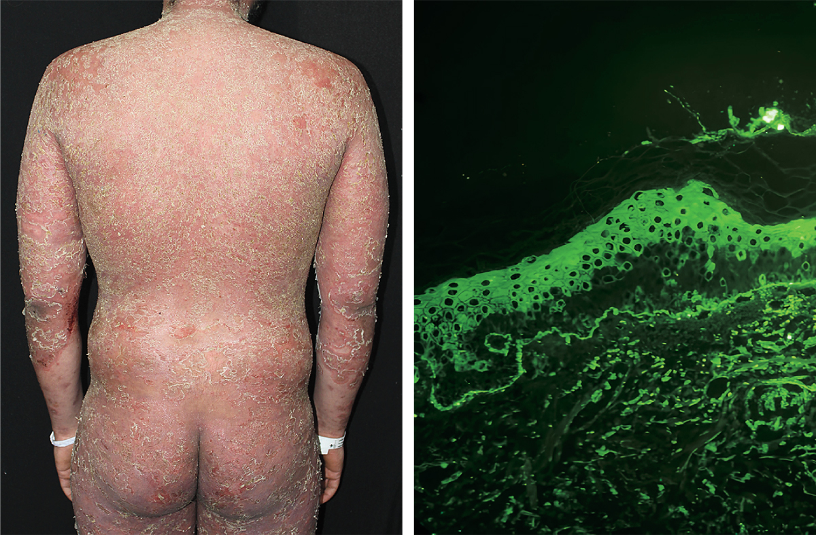
Image Challenge
Q:
A 22-year-old man presented to the dermatology clinic with a 1-year history of a red, scaly rash on his face and body. On physical examination, widespread erythroderma with overlying erosions, scaling, and crusting was observed. The oral mucosa was spared. A skin biopsy from the back showed superficial acantholysis (the loss of adhesion between keratinocytes). Direct immunofluorescence of the biopsy specimen showed intercellular IgG antibodies against desmoglein-1 in the superficial layers of the epidermis. What is the most likely diagnosis?
1. Bullous pemphigoid
2. Dermatitis herpetiformis
3. IgA pemphigus
4. Pemphigus foliaceus
5. Pemphigus vulgaris

Slide 2
Image Challenge
Q:
A 22-year-old man presented to the dermatology clinic with a 1-year history of a red, scaly rash on his face and body. On physical examination, widespread erythroderma with overlying erosions, scaling, and crusting was observed. The oral mucosa was spared. A skin biopsy from the back showed superficial acantholysis (the loss of adhesion between keratinocytes). Direct immunofluorescence of the biopsy specimen showed intercellular IgG antibodies against desmoglein-1 in the superficial layers of the epidermis. What is the most likely diagnosis?
Answer:
Pemphigus foliaceus
A diagnosis of pemphigus foliaceus was made. Pemphigus foliaceus is a type of pemphigus — a set of autoimmune blistering skin disorders — that develops in the superficial epidermis. It typically manifests with subcorneal blisters that turn into eroded, scaly lesions. Unlike pemphigus vulgaris, pemphigus foliaceus typically spares mucous membranes.

