Slide 1
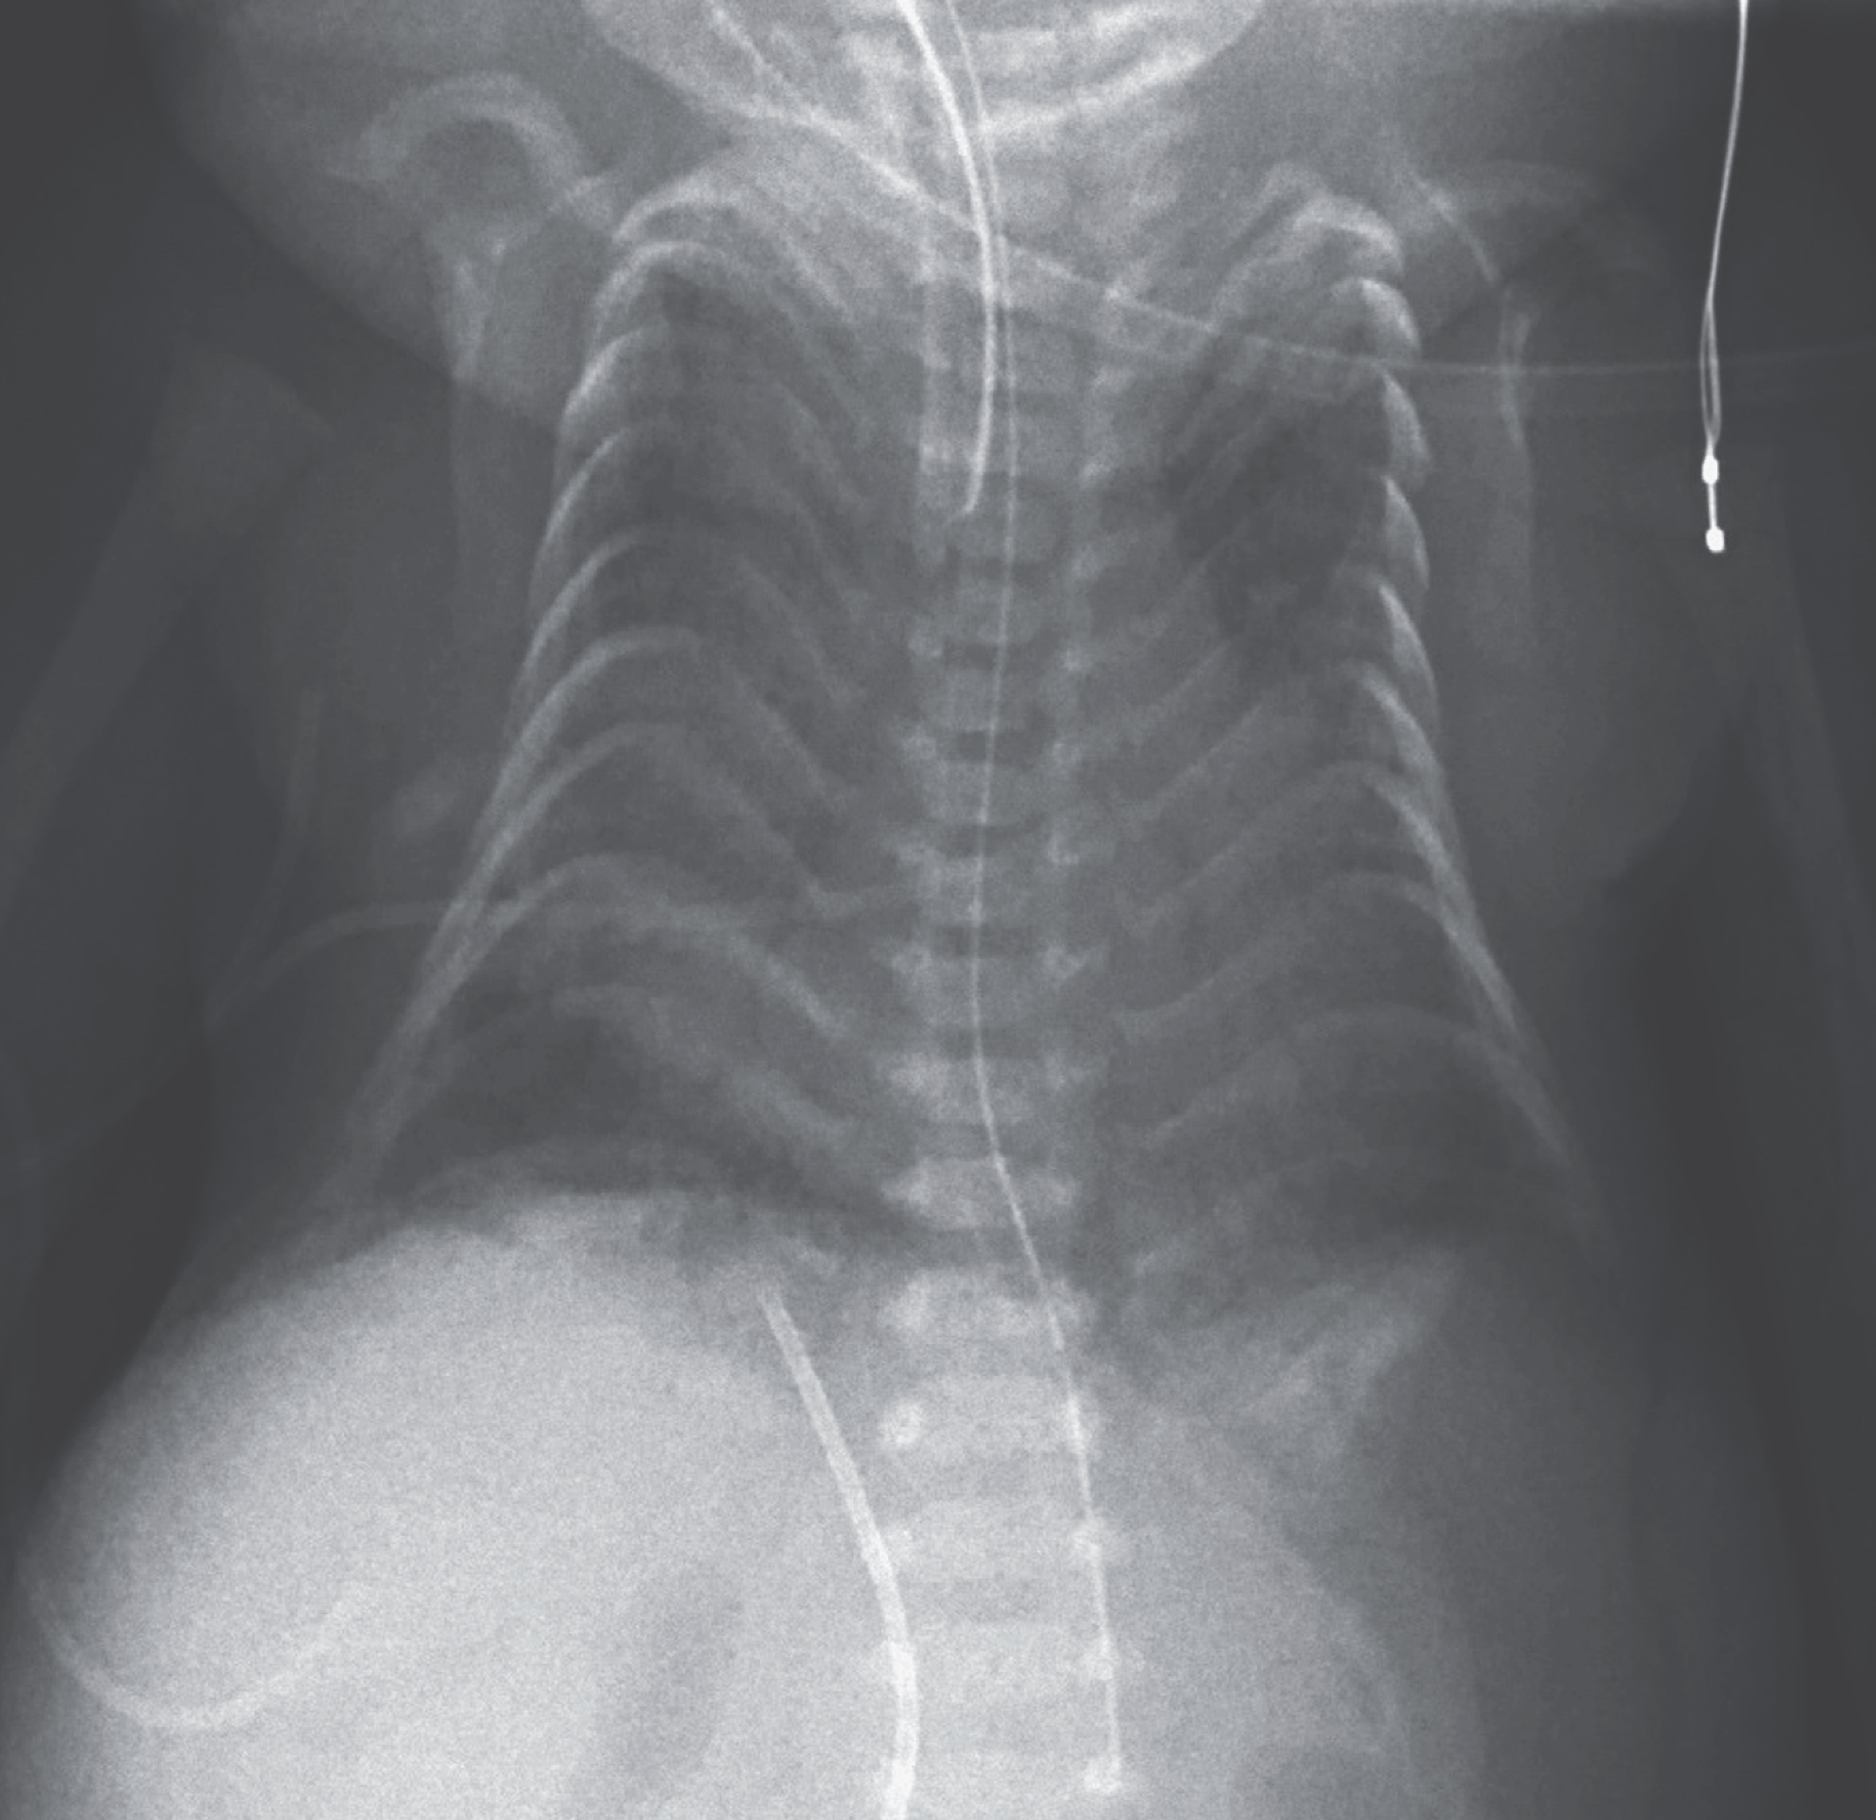
Image Challenge
Q:
A male neonate, born via cesarean section at 28 weeks of gestation, developed respiratory distress. The infant underwent intubation and surfactant administration through the endotracheal tube. Physical examination showed a giant omphalocele, webbed neck, and deformity of both hands. The pregnancy had been complicated by preeclampsia, and antenatal ultrasonography at 22 weeks of gestation had shown the presence of an omphalocele and polyhydramnios. Chest radiography on the first day of life showed a narrowing of the rib cage with crowding of the ribs in a “coat hanger” appearance. What is the most likely diagnosis/etiology?
1. Jeune syndrome asphyxiating thoracic dystrophy
2. Beckwith-Wiedemann syndrome
3. Respiratory distress syndrome of the newborn
4. Paternal uniparental disomy 14 (UDP 14 pat) thoracic dysplasia
5. Short rib polydactyly syndrome

Slide 2
Image Challenge
Q:
A male neonate, born via cesarean section at 28 weeks of gestation, developed respiratory distress. The infant underwent intubation and surfactant administration through the endotracheal tube. Physical examination showed a giant omphalocele, webbed neck, and deformity of both hands. The pregnancy had been complicated by preeclampsia, and antenatal ultrasonography at 22 weeks of gestation had shown the presence of an omphalocele and polyhydramnios. Chest radiography on the first day of life showed a narrowing of the rib cage with crowding of the ribs in a “coat hanger” appearance. What is the most likely diagnosis/etiology?
Answer:
Paternal uniparental disomy 14 (UDP 14 pat) thoracic dysplasia
On the basis of antenatal studies and the clinical presentation, a diagnosis of paternal uniparental disomy of chromosome 14 was suspected and confirmed by genetic testing. After receiving ventilator support for 4 weeks, the infant died from a ruptured omphalocele and septic shock.

