Slide 1
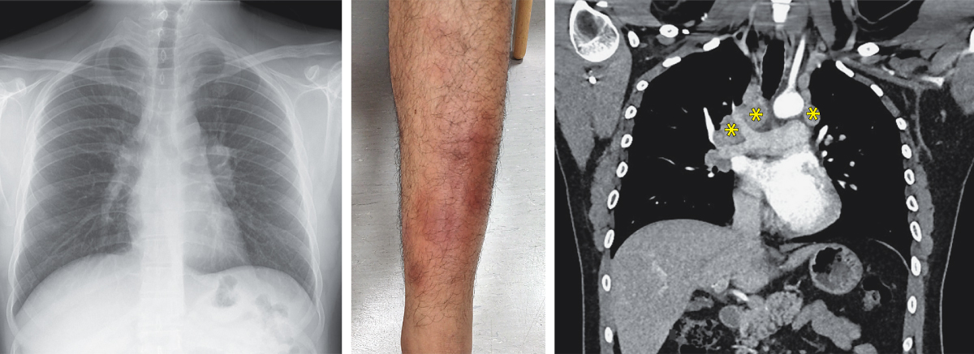
Image Challenge
Q:
A 26-year-old man who had emigrated from Nepal 7 years earlier was referred to the pulmonology clinic with several months of ankle swelling, a 2-month history of cough and unintentional weight loss, and a 3-day history of leg rash. A chest radiograph showed hilar lymphadenopathy (left). Physical examination was notable for erythematous, tender nodules and plaques on the anterior shins (middle). There was also swelling and tenderness of the ankles. Computed tomography of the chest showed enlarged mediastinal and hilar lymph nodes (right) and normal lung parenchyma. Transbronchial biopsy of the right paratracheal and hilar lymph nodes was performed. Histopathological analysis showed noncaseating granulomas. Microbiological studies for fungal and mycobacterial infections were negative, including a nucleic acid amplification test for Mycobacterium tuberculosis. What is the most likely diagnosis?
1. Extra-intestinal Crohn’s disease
2. Löfgren’s syndrome
3. Non-Hodgkin lymphoma
4. Non-tuberculous mycobacterial infection
5. Reactive arthritis

Slide 2
Image Challenge
Q:
A 26-year-old man who had emigrated from Nepal 7 years earlier was referred to the pulmonology clinic with several months of ankle swelling, a 2-month history of cough and unintentional weight loss, and a 3-day history of leg rash. A chest radiograph showed hilar lymphadenopathy (left). Physical examination was notable for erythematous, tender nodules and plaques on the anterior shins (middle). There was also swelling and tenderness of the ankles. Computed tomography of the chest showed enlarged mediastinal and hilar lymph nodes (right) and normal lung parenchyma. Transbronchial biopsy of the right paratracheal and hilar lymph nodes was performed. Histopathological analysis showed noncaseating granulomas. Microbiological studies for fungal and mycobacterial infections were negative, including a nucleic acid amplification test for Mycobacterium tuberculosis. What is the most likely diagnosis?
Answer:
Löfgren’s syndrome
A diagnosis of Löfgren syndrome — an acute form of sarcoidosis characterized by erthyema nodosum, migratory polyarthritis, and hilar lymphadenopathy — was made. A 6-week tapering course of an oral glucocorticoid was initiated, and the patient improved quickly.

