Slide 1
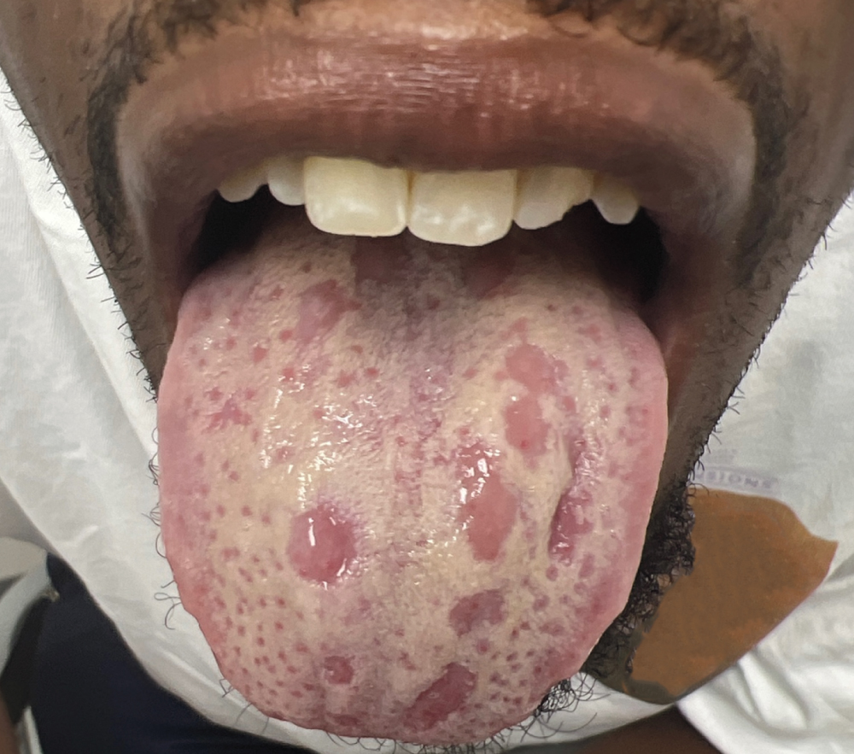
Image Challenge
Q:
A 29-year-old man with well-controlled human immunodeficiency virus infection presented with a 1-week history of a painful, whitish discoloration on his tongue. He also reported a 4-week history of painful ulcers on the scrotum. Physical examination showed smooth, pink, guttate macules on the tongue that were within a white coating that did not wipe off. No rash, ulcer, or lymphadenopathy was seen on genital examination; the reported lesions were presumed to have already resolved. Which of the following is the most likely cause of this patient’s tongue changes?
1. Geographic tongue
2. Lichen Planus
3. Oral leukoplakia
4. Secondary syphilis
5. Squamous Cell Carcinoma

Slide 2
Image Challenge
Q:
A 29-year-old man with well-controlled human immunodeficiency virus infection presented with a 1-week history of a painful, whitish discoloration on his tongue. He also reported a 4-week history of painful ulcers on the scrotum. Physical examination showed smooth, pink, guttate macules on the tongue that were within a white coating that did not wipe off. No rash, ulcer, or lymphadenopathy was seen on genital examination; the reported lesions were presumed to have already resolved. Which of the following is the most likely cause of this patient’s tongue changes?
Answer:
Secondary syphilis
Laboratory results performed on the day of presentation showed a serum rapid plasma reagin titer of 1:32 and a positive Treponema pallidum particle agglutination assay. A diagnosis of plaques en prairie fauchée (“mowed meadow”) tongue lesions in secondary syphilis was made. The mowed-meadow pattern of tongue lesions in secondary syphilis refers to the presence of depapillated patches of mucosa within a white layering on the posterior tongue. Treatment with a single dose of penicillin G benzathine was given with complete resolution seven days later.

